Slide 1
SLDV sales activities & status in Japan and my experience sharing
Yasumitsu Ito
Jan 28, 2013

Slide 2
Customers' status and trend

Slide 3
What company purchased SLDV in Japan?
Account Name | # of seats | # of v-seats | Revenue
Denso Corp | 40 | 61 | 593,584
Shizuoka University | 21 | 21 | 3,656
Toyota Motor Corp | 4 | 13 | 145,116
Honda R&D Co Ltd | 4 | 13 | 138,828
Hitachi Ltd | 9 | 12 | 104,935
Nissan Motor Co Ltd | 10 | 10 | 102,326
Aisin AW Co Ltd | 4 | 10 | 73,744
Panasonic Corp | 9 | 9 | 113,023
Isuzu Motors Ltd | 6 | 9 | 101,384
Advics Co Ltd | 8 | 8 | 104,174
Fujitsu Ten Ltd | 8 | 8 | 98,767
Mitsubishi Electric Corp | 4 | 7 | 89,058
Suzuki Motor Corp | 3 | 6 | 62,547
JATCO Ltd | 6 | 6 | 60,689
Mitsuba Corp | 5 | 5 | 61,151
Toyota Technical Development Corp | 5 | 5 | 48,012
Panasonic Advanced Technology Development Co Ltd | 4 | 4 | 52,326
Mitsubishi Motors Corp | 1 | 4 | 51,163
Hitachi Appliances Inc | 4 | 4 | 50,233
Nagoya University | 4 | 4 | 2,272
* Since 2007 through 2012

Slide 4
v-seat and Revenue history
v-seat
Revenue

Slide 5
Key customer case: DENSO-PV
Using SLDV for automation of unit testing.
Extract Atomic subsystems from a controller model
Add Test Objectives to satisfy DENSO's coverage criteria
Generate Test cases
Run simulation and record model coverage
DENSO-PV incorporated SLDV into their in-house tool.
The tool is used by mass production engineers.
Since they decided to deploy SLDV for mass production, 40 SLDV v-seats were sold in 2012.

Slide 6
Key customer case: Nissan Powertrain
Competition against Reactis
Nissan has a criteria to satisfy MC/DC at model-based testing.
Refer to Shuji's presentation at SKO2013.

Slide 7
Key customer case: Toyota
Fuel Cell team adopted SLDV at first.
Dividing a model so that SLDV can be adoptable.
Testable model is their priority.
SLDV Workshop had been provided to engineers from multiple divisions:
Engine, FC, HV, 1JS, 2JS, P-robot, GR, EIT
Active Safety team is also evaluating
Not applied to production team yet.

Slide 8
Key customer case: AISIN AW
Automation of verification is the key motivation.
They wants to front-load unit-level-testing what they do at code level to model level.
They are developing in-house tool and environment to do it.
Japan consulting team are engaging with them to assist developing the in-house tool.

Slide 9
Key customer case: Mitsubishi Electric EPS
Product:
Controller ECU for Electric Power Steering
Status:
Evaluating Fixed-Point controller modeling, code generation, and verification environment.
Comparing the environment with TargetLink + BTC tools.
Decided to deploy MathWorks toolchain on 2012.
Strategic Notes:
Engine div. in Mitsubishi Electric is using TargetLink since ~2003.
EPS is the first division who uses EC+SLDV in Mitsubishi Electric. We aim to expand this usage widely in the company.

Slide 10
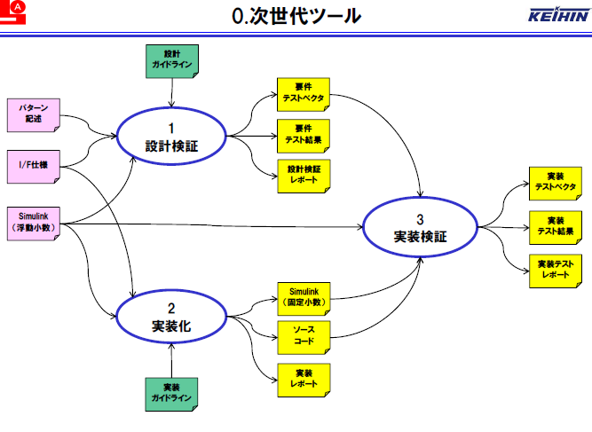
Key customer case: Keihin
Motivation is to define their MBD process and to develop in-house tool to be used by production users.
They evaluated cmtdtool to understand how automation can be done in MATLAB/Simulink environment.
To develop requirement-based-testing tool using cmtdtool was the 1st step.
The tool in the next generation
Requirement-based-test-vectors
Property description
Requirement-based-test-results
I/F specification
Requirement-based-test-report
Design
Verification
Requirement-based-test-vectors (Implementation)
Simulink
Implementation
Verification
Requirement-based-test-results (Implementation)
Simulink (Fixe-point)
Requirement-based-test-report (Implementation)
Implementation
Source code
Implementation report

Slide 11
Common observations in Japan
There is a key engineer(s) who develop MBD environment for other users.
No domain specific (OEM / Supplier, Engine, Transmission, Chassis, Body, Safety, ..).
Many of customers have motivation to improve development process with MBD.
Many of customers are also evaluating competitor tools.

Slide 12
Customers' motivation
Test automation
ISO 26262
Reducing cost by MBD adoption
Front-loading software test methods into model-level.
High interest in formal verification
Many talks at public seminars about Formal Methods
SPIN, NuSMV, VDM, etc
ISO26262
Evaluating not only SLDV but also BTC tools, Reactis, T-vec, etc.
BTC (Omron, Jatco, Mitsubishi Motors, Toyota HV, Fujitsu-ten)
Reactis (AISIN ,Advics, Keihin, Honda ,Nissan)

Slide 13
Observations from Domain-point of view
Engine & Power-Train
Most likely to use MBD and matured to MATLAB/Simulink
Early adopter and has a lot of model assets
Sometimes difficult to adopt SLDV because of old-style models
Transmission
Likely to use MBD and matured.
Eager to adopt automatic model verification
Chassis
Relatively new to MBD and know benefit of introducing MBD (Supplier)
Body
Usually new to MBD.
There are many timers and counters that may have difficulty with adopting SLDV.

Slide 14
Competition with 3rd-party tools

Slide 15
Observation from competition in Japan
From my sense, 80% of the customer who evaluates SLDV also evaluates competitor tools such as Reactis, BTC Embedded Validator / Embedded Tester, SCADE, T-Vec.
We had several experiences that we lost opportunities because of lack of initial support.
To win against competitors, MathWorks engineering support at the initial evaluation stage is the key factor.

Slide 16
Reactis
Reactis is based on stochastic method.
Advantage:
According to customers' report, SLDV generates test cases that achieve test objectives with fewer simulation steps.
Usually, SLDV achieves higher coverage.
Disadvantage:
No additional modifications are required to generate tests for a model that have unsupported features by SLDV.
Reactis supports a plant model but SLDV doesn't.
Comment:
Co-existing would be possible.

Slide 17
BTC Embedded Validator / Embedded Tester
TargetLink-based verification tool that supports automatic test generation, property proving.
Advantage
Doesn't support floating-point model
Requires TagetLink code generation and license
Later verification
Disadvantage
Fixed-point analysis is aften lightweight
Pattern language are provided for property proving.

Slide 18
Advantages against Competitors
Seamless environment with unified tool chain
Block conversion is not needed.
Seamless Traceability
Easy to apply new features
Simulink simulation as true reference
Early Verification at upstream development process
Advantage of recognizing Intermediate Representation that is used for simulation, code generation, and model verification.
Applying model verification on both floating- and fixed-point model.
Enables to apply model verification at upstream development process.
Support capability
Cost advantage
Continuous improvement of MBD environment

Slide 19
JMAAB activities

Slide 20
JMAAB Activities V&V Working group in 2007-2008
JMAAB web page (Contact Hiro Iino for ID and Password )
http://jmaab.mathworks.jp/contwg/index.php
http://jmaab.mathworks.jp/contwg2/index.php
V&V guideline published
The guideline is focusing on how to make use of SLDV
Verification process can be divided into 2 processes
Simulation verification
Property proving
General JMAAB user (~1900 are registered) can download this guideline

Slide 21
JMAAB Activities V&V Working group in 2007-2008
Actual Requirement
Proposed verification process (En)
Requirement Specification
Structural Design
Design verification spec
Verification Spec. (S)
Verification Spec. (P)
Design controller model
Test vectors
Describing properties
Simulation verification model
Property proving model
Simulation verification
Proving property
Guideline document
Verification report

Slide 22
JMAAB Activities JMAAB CMTD WG
V&V Guideline have been settled.
Practical methodology to apply the guideline was not discussed.
Activities:
Collect and learn software test methods
Discuss how to apply those methods in Simulink environment
Bind the software methods and development process standards.
http://inside.mathworks.com/wiki/JMAAB_CMTD_WG

Slide 23
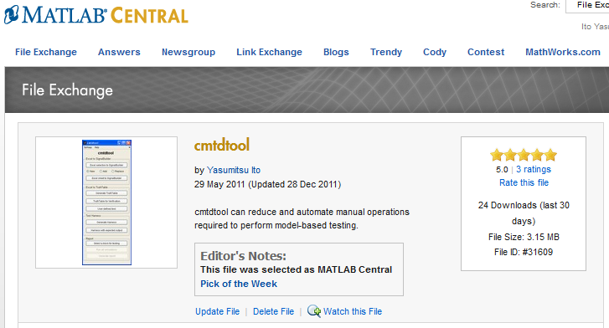

JMAAB Activities cmtdtool developed for JMAAB CMTD WG
A tool uploaded on MATLAB Central
Initially developed for JMAAB-CMTD-WS (Control Model Test Design Workshop) in 2010.
You can search it with Google
Download it from:
http://www.mathworks.com/matlabcentral/fileexchange/31609-cmtdtool

Slide 24
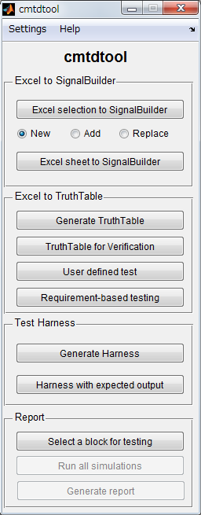
Overview of cmtdtool
Excel to Signal Builder
Import test vectors from Excel spread sheet into Signal Builder block
Excel to TruthTable
Import a Truth Table written in Excel spread sheet into TruthTable block in Stateflow.
Test harness
Generate a test harness model from a controller model.
Report
Generate automatic test report from a test harness model.
Typical test activity
Definition
Execution
Evaluation
Reporting

Slide 25
Materials

Slide 26
SLDV / V&V Materials #1
Presentation materials new customers
Model-based Verification introduction
Introduction to SLDV
Detailed materials and demos for SLDV evaluation users
Block replacement
Parameter handling
How to work with Large models & How SLDV works

Slide 27
SLDV / V&V Materials #2
MBD training
MBD-PCG training
Develop controller of LEGO mindstorms NXT
SLDV workshop
1-day, 2-day
Run & study SLDV analysis for example models
V&V jumpstart by consulting team

Slide 28
Best practices of evaluation support
At the initial stage of evaluation, it better propose to have technical exchange session with the customer.
Provide SLDV workshop or a part of the workshop if it is needed.
Conduct the customer to try to start with a small model to understand how SLDV works.
Going on-site and looking at the customer model are the shortest path to solve the issue.

Slide 29
Answering questions you might have

Slide 30
How big a role did JMAAB play in promoting SLDV?
Not sure.
Many customers are communicating each other at meetings or conferences not just at JMAAB but also at public events.
A champion may influence on other departments at his/her company via intra communication.

Slide 31
Do OEMs require suppliers to achieve test coverage or some quality metrics?
Not observed.
Suppliers are preparing establishing high quality development process before OEM requests it.

Slide 32
Were the customers already interested in formal methods or did you have to sell the idea to them?
50% and 50%
From my observation, formal methods is not a key technology for customers.

Slide 33
Do customers have engineers dedicated to the evaluation?
Yes in many case. If not, we propose it.

Slide 34
Do customers usually to a competitive evaluation (against BTC, Reactics …)?
Yes. > 80%.

Slide 35
Are customers willing to adapt their process around SLDV limitations?
Usually.
Without adopting SLDV, the early verification cannot be achieved.

Slide 36
Are Japanese customers modeling style better for SLDV?
Not sure.
S-function is hardly used.

Slide 37
Have we had successes in converting customers from Reactics to SLDV?
Yes.
Advics, Jatco, Nissan were comparing against Reactis.

Slide 38
Do you always do a Pilot project?
For the key customers, AE or PE involve it at initial stage of evaluation.
Sometimes, the evaluation can be observed through Technical support.

Slide 39
Do you typically work with customers building new models or do they apply SLDV to existing models?
Ask to pick some small examples from existing models when customers start evaluation.
We help applying SLDV on them.
For real adoption, we ask them to apply new models.
Sometimes, customers ask us to help applying SLDV before they start building new models.

Slide 40
Did MWJ work on customer’s model to make SLDV work with larger models, or did customers do it themselves?
We experienced SLDV analysis with >10000 objectives for evaluation purpose. MWJ did the analysis.
We encourage customers to apply SLDV on unit-level-component at first.
We sometimes go on-site to provide face-to-face support.

